Slide 1

Emergency Information Directory
By
Moshiur Tonmoy & Mahirbin Foysal

Slide 2
Introduction
To bring all emergency information in one shed
Emergency support

Slide 3
Motivation
Needs in daily life
Real-life experience
No existence of such useful services!

Slide 4
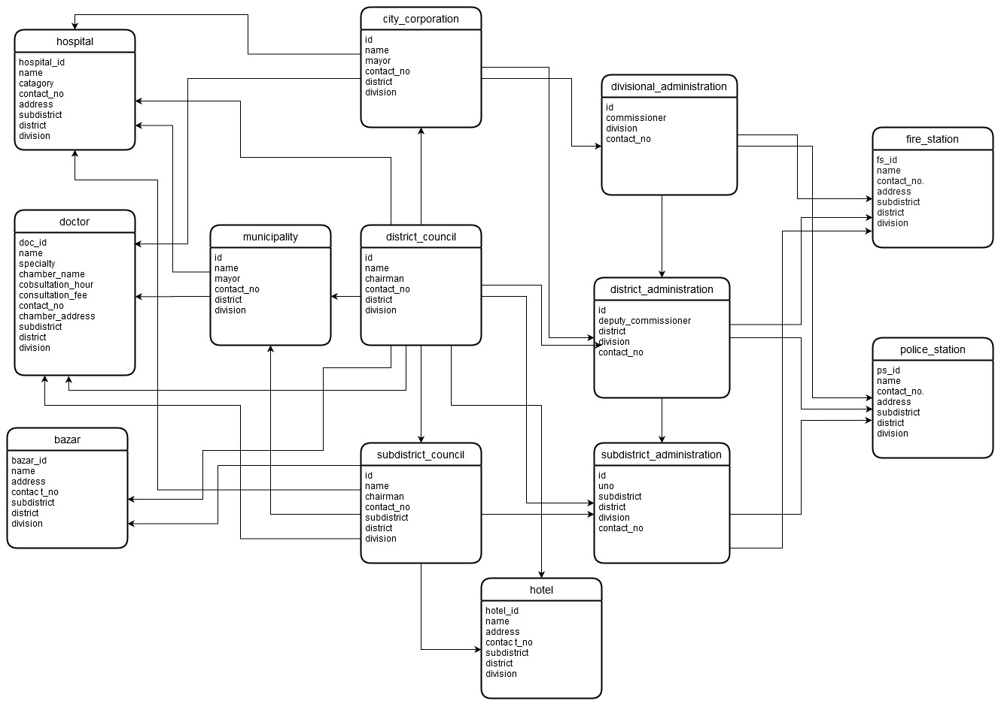
Schema Diagram

Slide 5
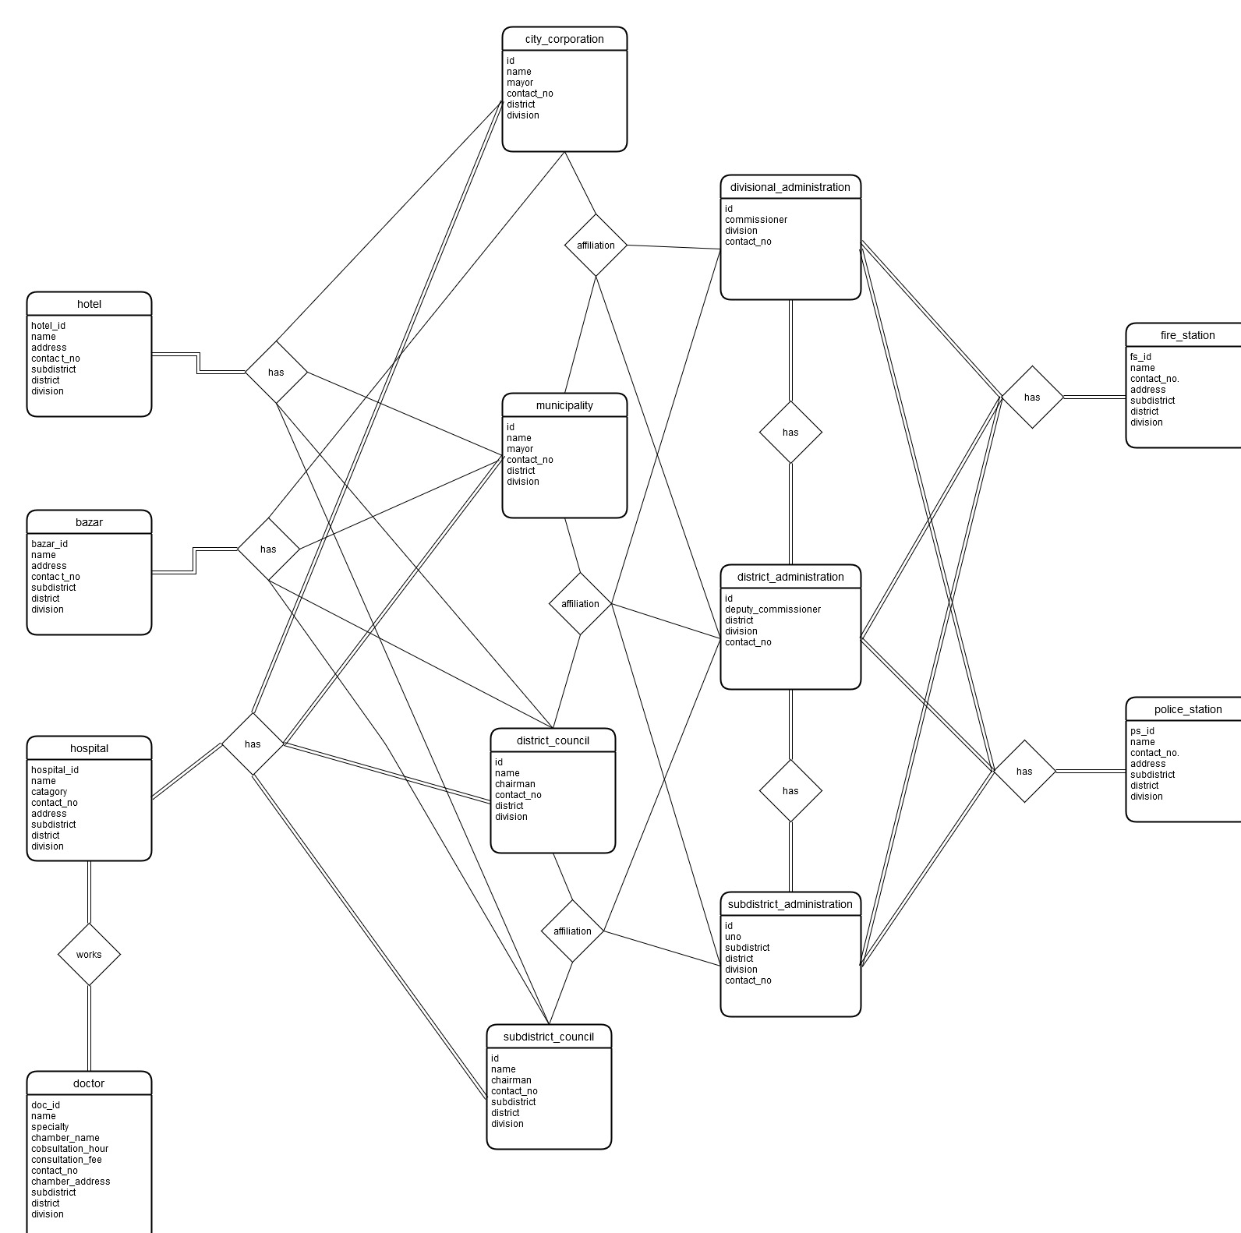
ER Diagram

Slide 6
How it works?
Suppose, you are looking for information of a Neurosurgeon in your subdistrict…
all you have to tell us your subdistrict name and to mention requirements.
We’ll provide you all you need to know about your desired doctor.
Same process goes for police, authority, local governments etc.

Slide 7
The End!

